Slide 1
Is future transport here?
Comparing EV efficiency to ICE vehicles
Group 6: Julian Pecino, Jeremy Del Moral, Elijah Montgomery, Joshna Rence

Slide 2
Questions to be Answered:
Budget
Is an EV affordable for a median income earning family household in the US?
EV as Commercial Vehicle
Is an EV appropriate for commercial applications including cross country transport?
Affordability
Affordability considerations over a 10-year span for Tesla Model 3 and Toyota Camry

Slide 3
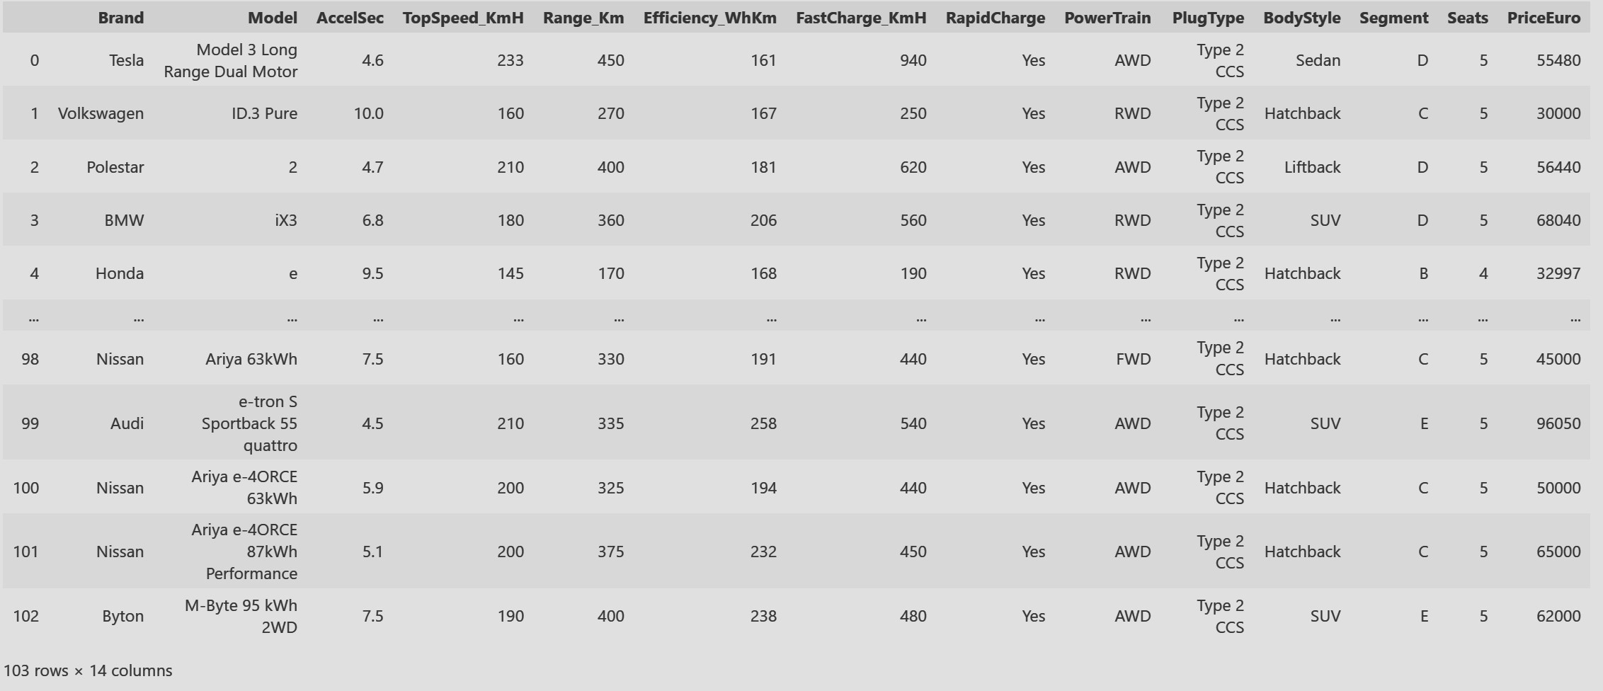
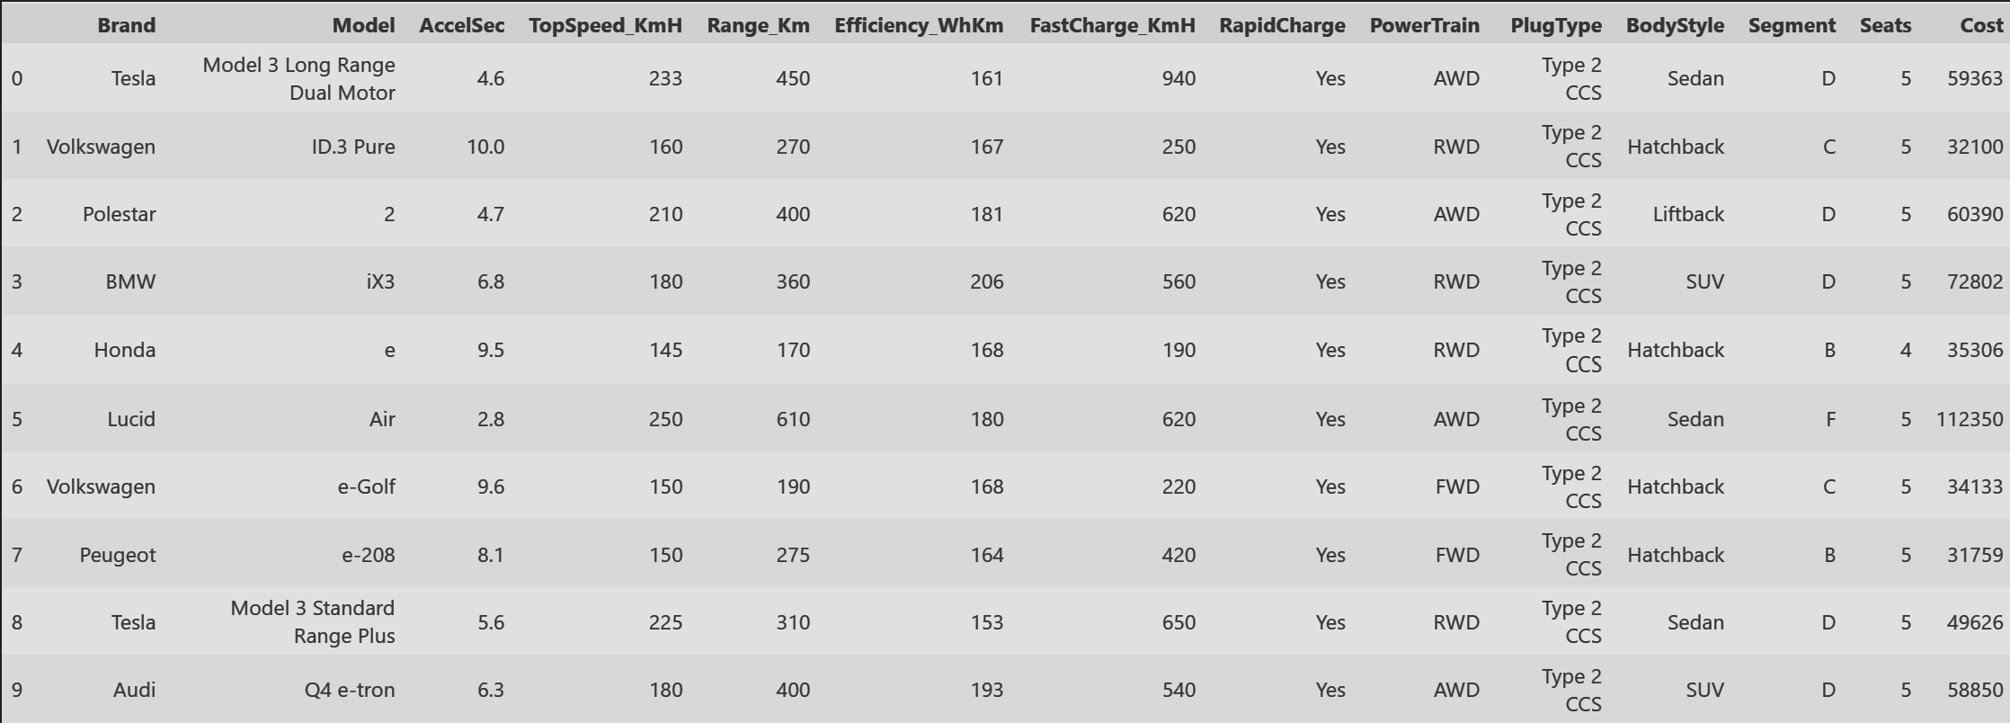
Electric vehicle dataset
Data Cleaned up:
Conversion of cost from Euro to US Dollars.

Slide 4

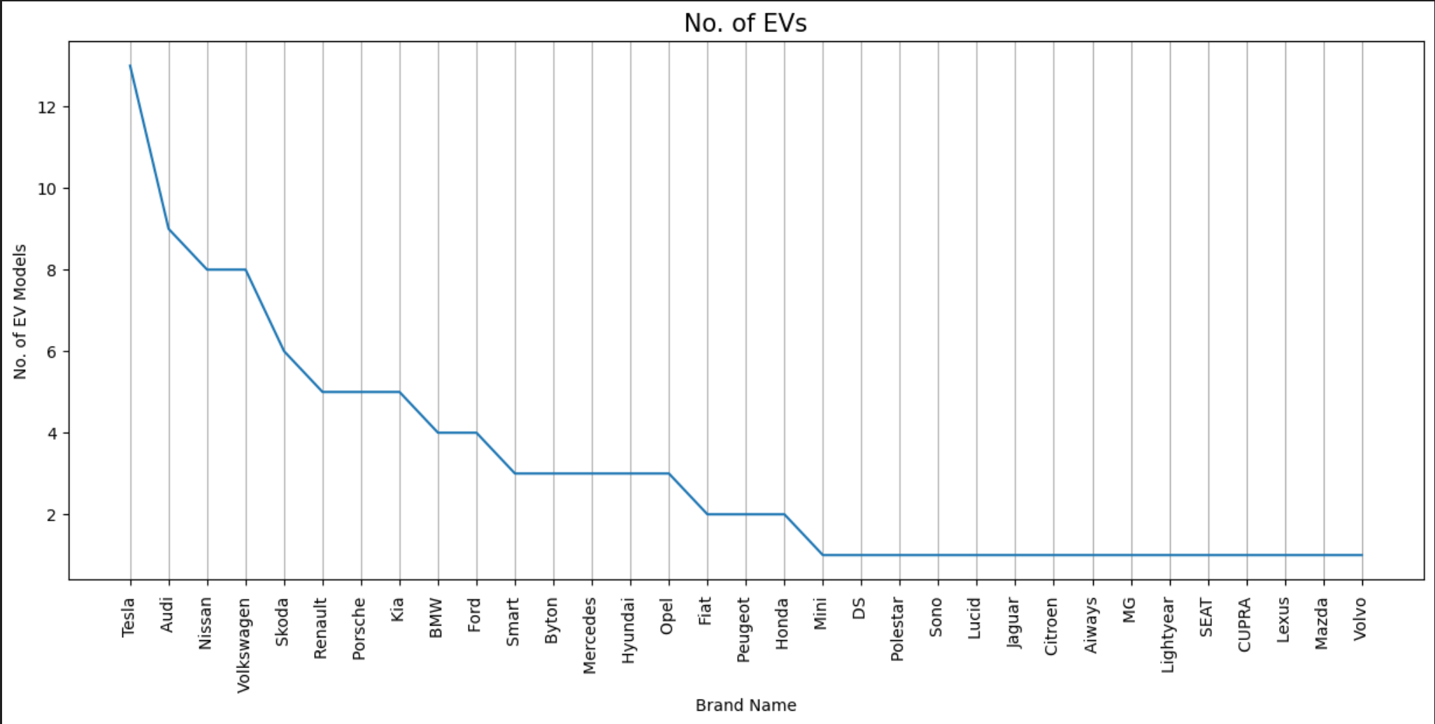
Electric vehicle Models
From a first order analysis, it is evident that there are around ~60 EV options less than $50k price range.
The graph shows the number of Electric Vehicle models per car manufacturing companies with Tesla leading the chart.

Slide 5

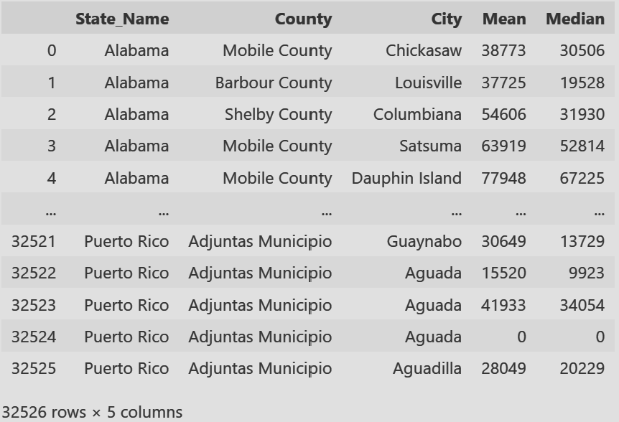
US MEDIAn income details

Slide 6
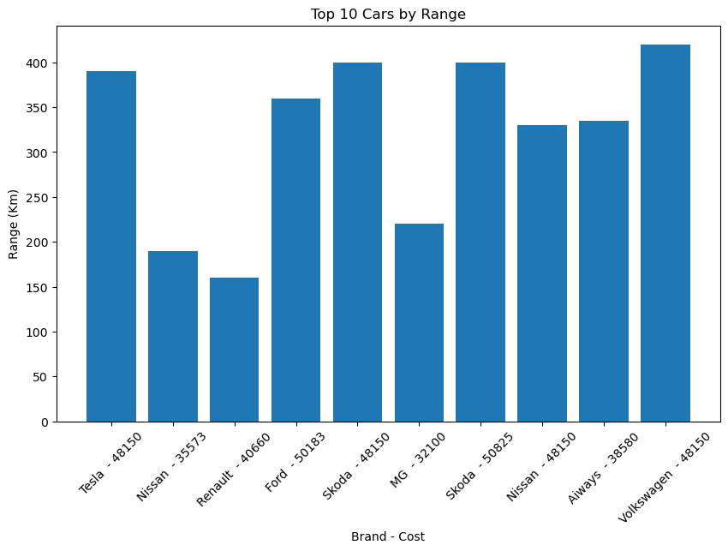

Ranking electric vehicles
According to a survey on median income across US cities, it is evident that electric vehicles (EVs) could be reasonably affordable for most households.
The top 10 cars are ranked based on their range and efficiency, making them potential options to consider for this budget.

Slide 7

Dataset Used:

Slide 8

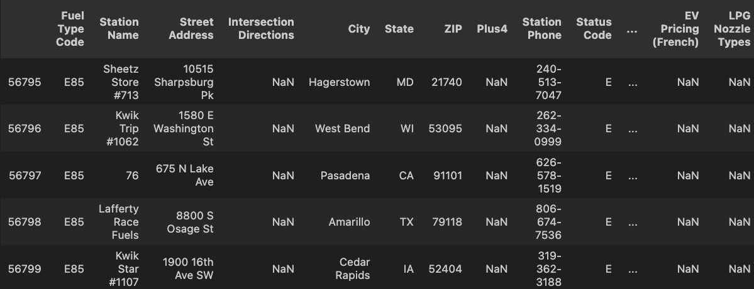

Dataset Used:

Slide 9

Commercial Applications:
Charging stations well established in major cities and coastal cities
Charging limited in the Midwest and Southern States

Slide 10
Commercial Applications:

Slide 11
Dataset Used:

Slide 12
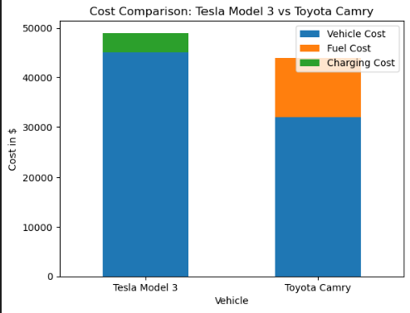
Affordability:
Initial investment towards an EV seems high but more the usage charging cost become more effective compared to fuel cost (eg after ~7 years).
Price range seems comparable after 10 years of usage.
Additional maintenance cost, insurance and repair not considered in this chart.
This also proves to be nature friendly solution with less emission and conservation of burning fuel energy.

Slide 13
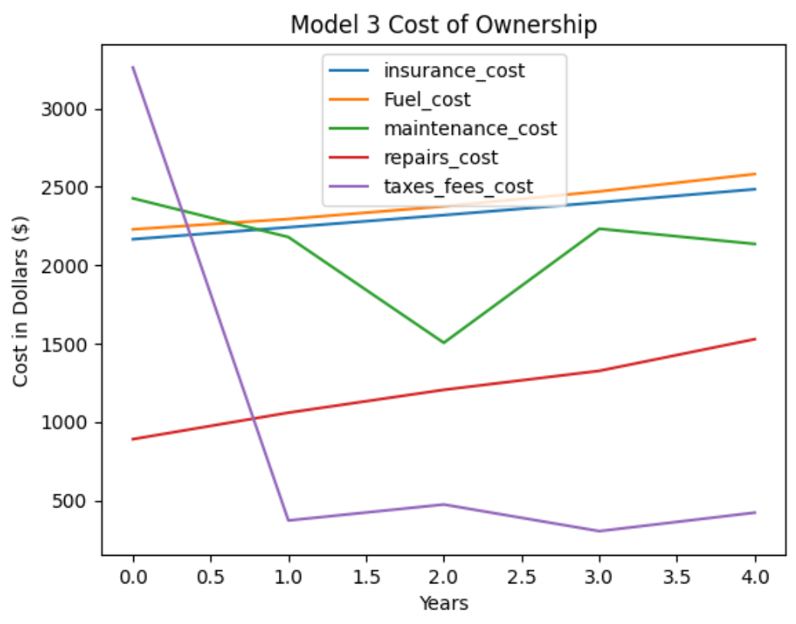
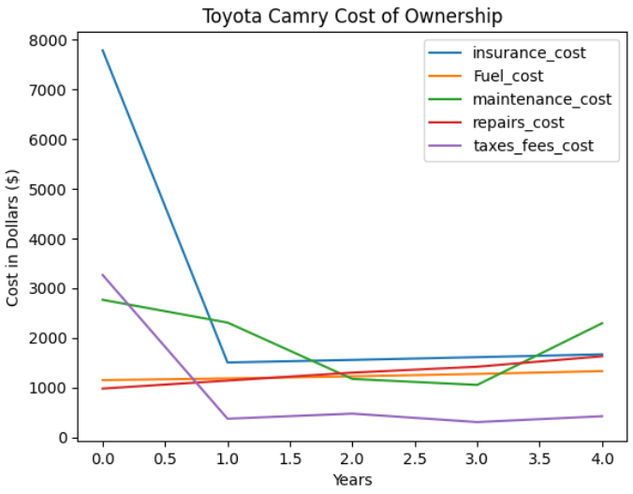
Affordability:
M

Slide 14
Questions:

